Slide 1
SOFTWARE PIRACY DETECTION
OPCODE PATTERN RECOGNITION USING HIDDEN MARKOV MODEL, OPCODE GRAPH SIMILARITY AND CLASSIFICATION BY SUPPORT VECTOR MACHINE

Slide 2
SOFTWARE PIRACY
Software piracy is unauthorized use , copying or distribution of licensed software.
Violation of End User License Agreement (EULA)

Slide 3
DATASET
Pirated software which is available online are exact copies of original software with only the License Purchase prompt broken or bypassed through reverse engineering.
Created own dataset using morphing generator.
Multiple copies of same software are created with a varying range of altering opcode statistics

Slide 4
MORPHING GENERATOR
Followed 2 techniques for generating pirated copies and benign copies of our sample software(ELMEDIA video player)
Dead Code Insertion
Permutation of code blocks
To avoid overfitting, extracted most frequent 29 opcodes and labelled everything else as “Other”.

Slide 5
MORPHING GENERATOR
Dead Code Insertion
Created heavily morphed copies by inserting dead code from 5% to 90% . Consider them as pirated versions of original software.
Permutation of code blocks:
We created slightly altered copies by creating frames (2 to 11) and randomly permuting them .We consider them as benign samples.

Slide 6
HIDDEN MARKOV MODEL
Extract Top 30 opcodes which are frequently used.
Start by training on benign sample of 50000 opcodes.
Choose an optimal N value ( In this case N=3) and determine A, B and pi matrices
Score the model with test samples ( morphed copies 10-90%)
Plot the results

Slide 7
HMM - Scoring Phase
Log likelihood probability of models can be considered as scores.
Compare scores of benign sample versus all morphed samples.
Normalize scores so that it is easier to understand.

Slide 8
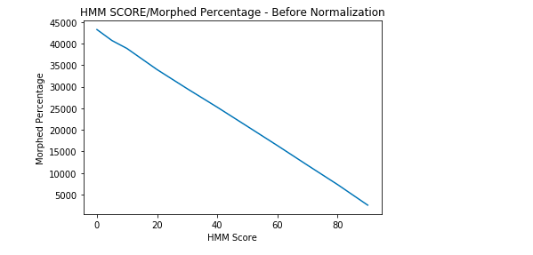
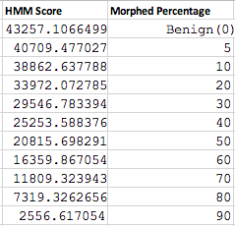
HMM Score (Before Normalization): Morphed Copies

Slide 9
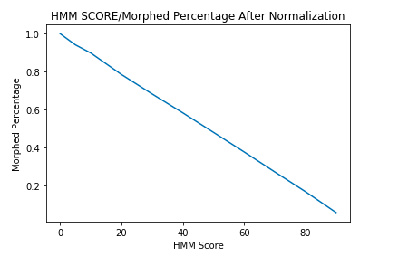
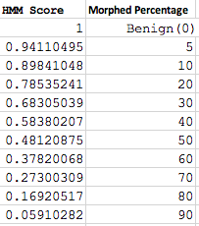
HMM Score (After Normalization): Morphed Copies

Slide 10
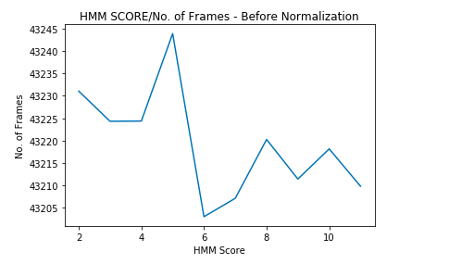
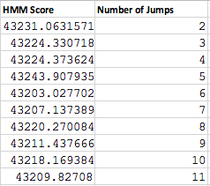
HMM Score ( Before Normalization) : No. of Frames

Slide 11
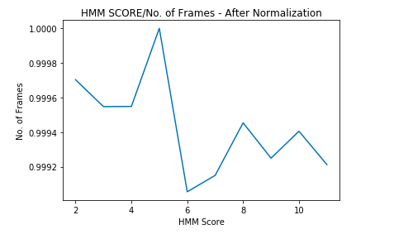
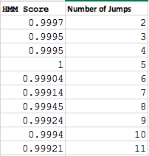
HMM Score ( After Normalization) : No. of Frames

Slide 12

OPCODE GRAPH SIMILARITY(OGS)
OGS matrix denotes the overall probability of Opcode “X” followed by Opcode “Y” in the entire opcode sequence.
We consider most frequent 29 opcodes and labeled everything else as “Other”
Hence OGS_matrix is 30X30
Normalized by row sum
OGS score=

Slide 13
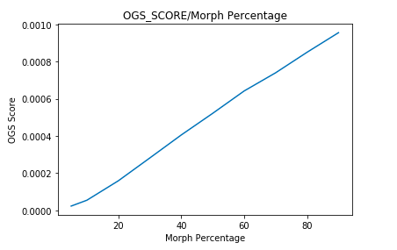
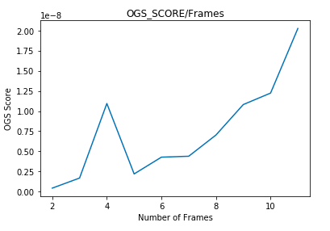
OGS SCORE (Base Matrix- Original Opcode Sequence)

Slide 14
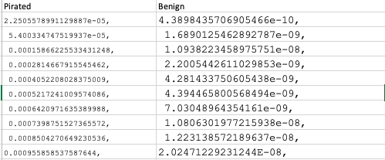
OGS SCORE TABLE (Base Matrix -Original Opcode Sequence)

Slide 15
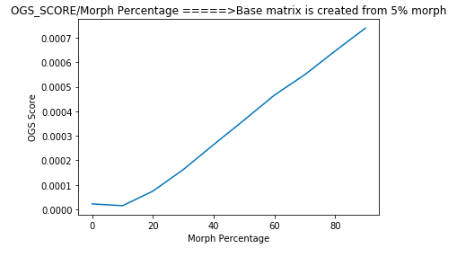
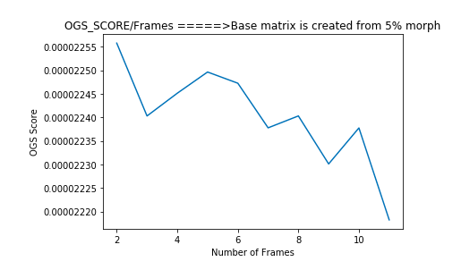
OGS SCORE (Base Matrix - 5% morph)

Slide 16
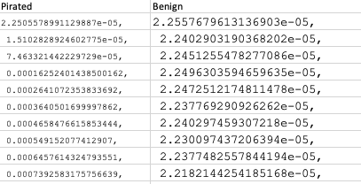
OGS SCORE TABLE (Base Matrix - 5% morph)

Slide 17
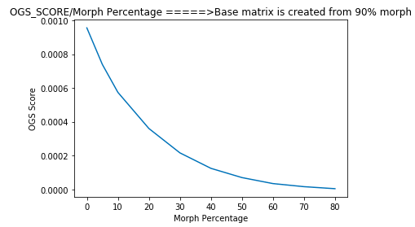
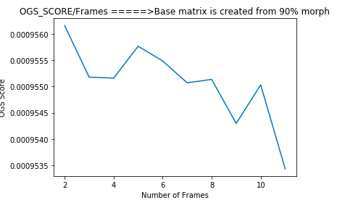
OGS SCORE (Base Matrix - 90% morph)

Slide 18
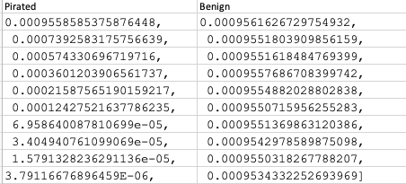
OGS SCORE TABLE (Base Matrix - 90% morph)

Slide 19
SUPPORT VECTOR CLASSIFIER
Feed OGS and HMM Scores into Support Vector Classifier to check results.
Input To the SVC:
Normalized OGS and Normalized HMM scores
Classifier Labels ( 0-Pirated 1- Benign)
Split data into train and test and predict if test data is able to classify samples accurately

Slide 20
SUPPORT VECTOR CLASSIFIER
Use three different kernels for experimenting:
Linear
RBF
Sigmoid
Check accuracy and plot graphs.

Slide 21
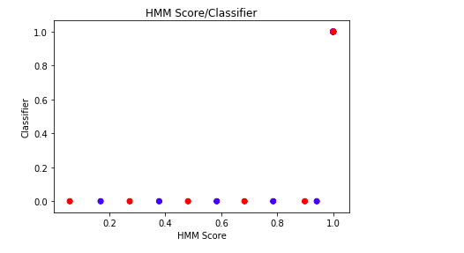
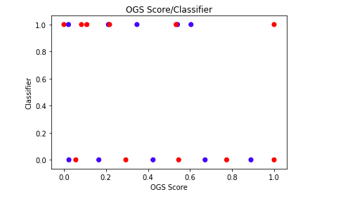
Linear Separation ( HMM/OGS)

Slide 22
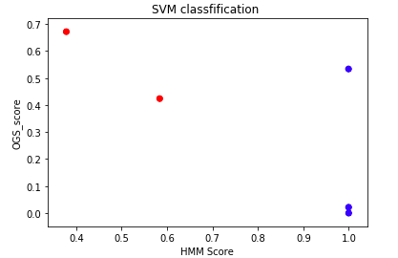
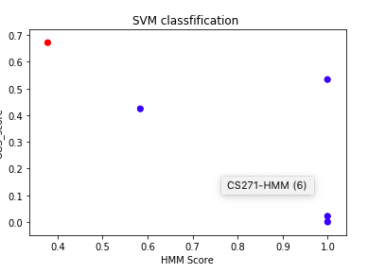
SVM Classifier - LINEAR /RBF/SIGMOID kernels
Linear Accuracy =100
RBF Accuracy =80
SIGMOID Accuracy =80

Slide 23
FUTURE WORK
Test on more executable files , malware and benign and compare results
N-grams of opcodes and bytes.

Slide 24
THANK YOU

